Slide 1
Marketing Campaign Effectiveness Analysis
Taiwo O. Elewode
Notes:
Overview of findings demonstrating data-driven insights for improving Unilever Nigeria’s marketing performance.

Slide 2
Introduction
Marketing campaigns are critical for Unilever Nigeria’s growth in a competitive FMCG market.
The company invests heavily in advertising, promotions, and influencer partnerships.
Challenge: Fragmented data and lack of clear performance measurement hinder strategic decisions.
This analysis leverages predictive analytics and visualization to transform raw data into actionable insights for campaign optimization. (Harvard Business Review, 2022)
Notes:
Unilever operates in a highly competitive environment where marketing spend must deliver measurable returns. This project addresses the challenge of fragmented data and unclear performance metrics by applying predictive analytics to guide strategic decisions.

Slide 3
Objective
Use predictive analytics to evaluate campaign performance and boost Return on Marketing Investment (ROMI). (Brownlee, 2020; Singh, 2025)
Notes:
Purpose is to shift from intuition to data-driven campaign strategies.

Slide 4
Business Problem
High marketing spend with unclear performance drivers.
Inability to accurately select high-ROI campaigns.
Notes:
Lack of model-based targeting leads to inefficient budget allocation.

Slide 5
Solution Approach
Models: Logistic Regression and Random Forest.
Preprocessing: Encoding, scaling, stratified train-test split. (Brownlee, 2020; Van Dorpe, 2018; Galarnyk, 2025)
Notes:
Models chosen for interpretability and predictive strength.

Slide 6
Dataset Overview
Source: Kaggle Bank Marketing dataset (~41,176 rows).
Features: Demographics, campaign history, economic indicators.
Target: response_binary (0 = No, 1 = Yes).
Notes:
Dataset reflects real-world marketing response patterns.

Slide 7
Preprocessing & Data Split
One-hot encoding for categorical variables. (Van Dorpe, 2018)
Standard scaling for numeric features. (Galarnyk, 2025)
Train-test split: 70/30 ratio, stratified. (Brownlee, 2020; Raheja, 2025)
Notes:
Ensures balanced and clean data for modeling.

Slide 8
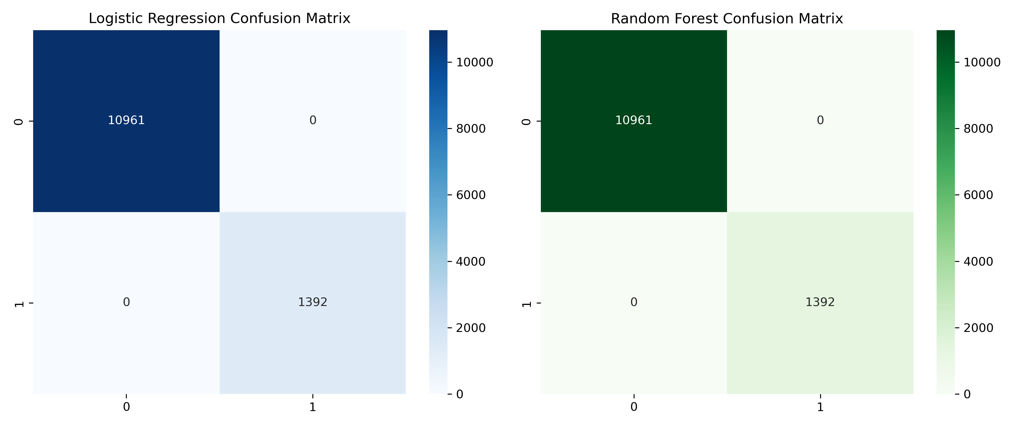
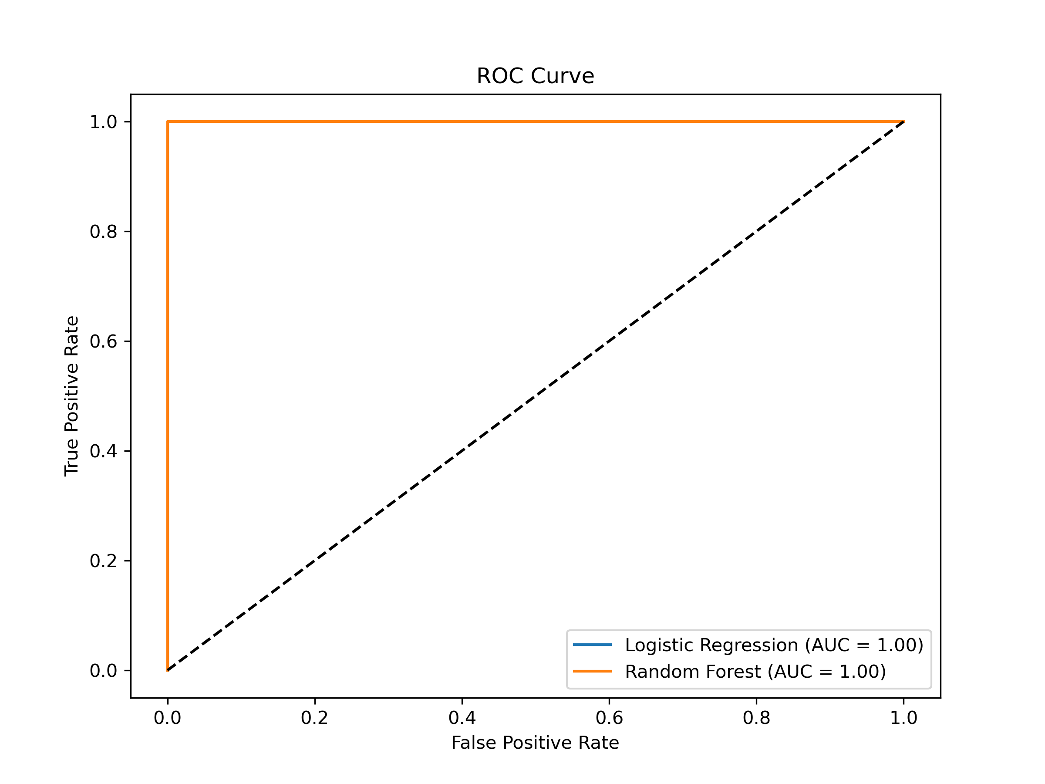
Model Performance
Metrics: Accuracy, Precision, Recall, F1-score.
ROC Curve comparison. (Or, 2020; Brownlee, 2020)
Notes:
Both models achieved strong predictive performance.

Slide 9
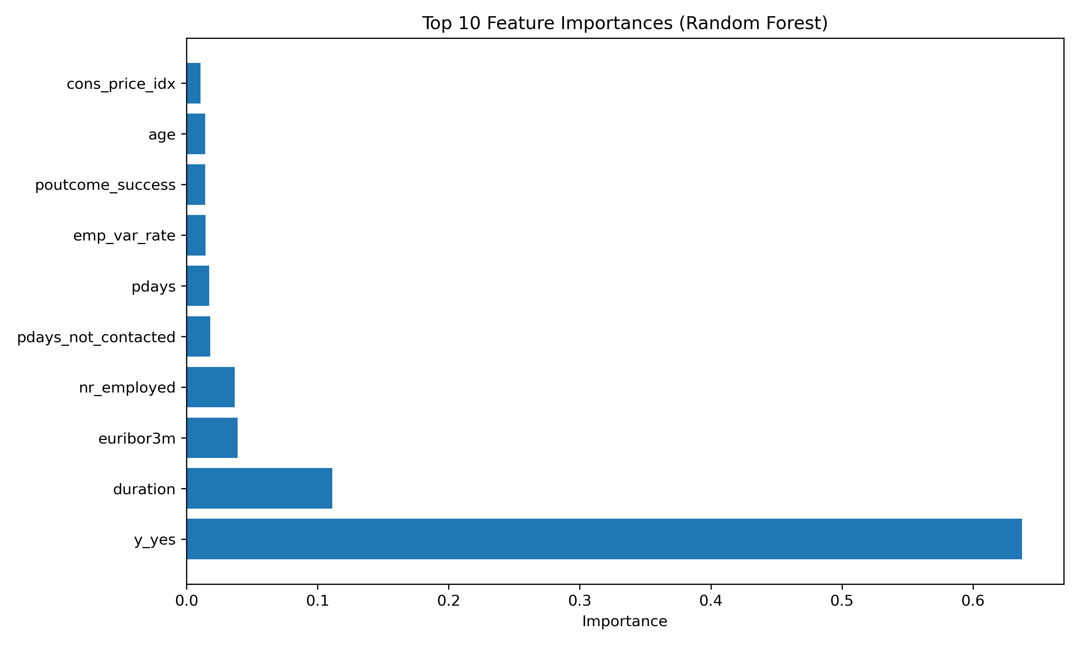
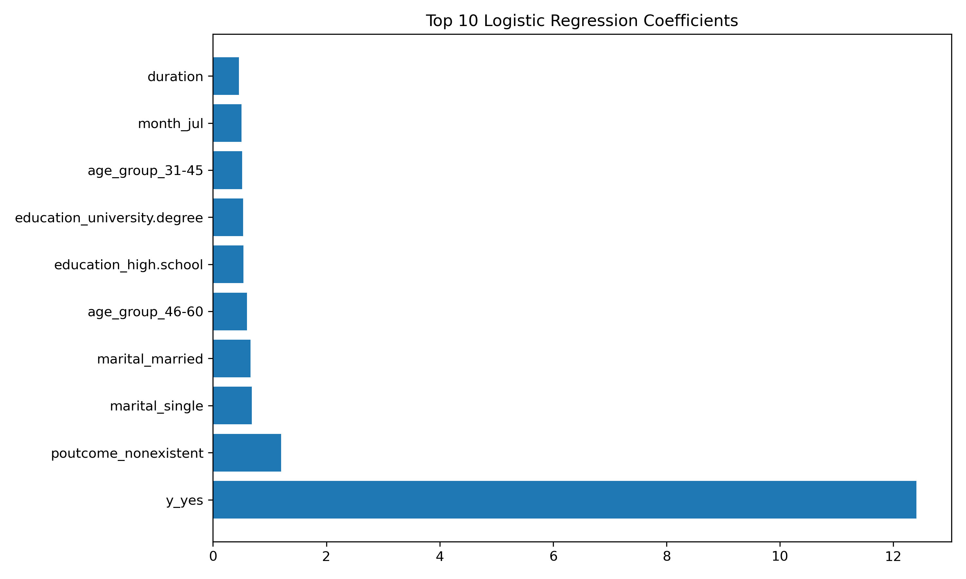
Key Findings
Top predictors: pdays, previous, duration, euribor3m, nr_employed. (Sruthi, 2023; Louppe, 2015)
Notes:
Customer engagement history and economic conditions drive success.

Slide 10
Business Insights
Recent interactions and longer calls increase conversion.
Middle-aged professionals respond better. (Naidu, 2019; Galarnyk, 2024)
Notes:
Targeting these segments improves campaign ROI.

Slide 11
Business Value
Optimized ROMI through targeted campaigns.
Reduced waste via data-driven decisions. (Zinkevich, 2024; DeVries et al., 2025)
Notes:
Predictive analytics enhances strategic marketing decisions.

Slide 12
Recommendations
Prioritize recent contacts and longer call durations.
Align campaigns with favorable economic conditions.
Target age 31–45 and professional occupations. (SelectHub, 2023; DeVries et al., 2025)
Notes:
These actions maximize campaign effectiveness.

Slide 13
Next Steps
Integrate models into CRM for automated targeting.
Build real-time dashboards.
Validate models periodically; adopt MLOps. (Pelletier, 2024; Zinkevich, 2024)
Notes:
Operationalizing insights ensures sustained performance.

Slide 14
References
Brownlee, J. (2020, August 26). Train-test split for evaluating machine learning algorithms. MachineLearningMastery. https://machinelearningmastery.com/train-test-split-for-evaluating-machine-learning-algorithms/
DeVries, S., Krishnamurthy, G., & Najafzadeh, H. (2025, November 19). Announcing the updated AWS Well-Architected Machine Learning Lens. AWS Architecture Blog. https://aws.amazon.com/blogs/architecture/
Galarnyk, M. W. (2025, August 4). Train test split: What it means and how to use it. Built In. https://builtin.com/data-science/train-test-split
Louppe, G. (2015). Understanding random forests: From theory to practice [PhD thesis]. arXiv. https://doi.org/10.48550/arXiv.1407.7502
Pelletier, H. (2024, March 29). Track your ML experiments. Towards Data Science. https://towardsdatascience.com/track-your-ml-experiments-9d2ea8cbeb02
Raheja, S. (2025, May 1). Train-test-validation split in 2025. Analytics Vidhya. https://www.analyticsvidhya.com/blog/2023/11/train-test-validation-split/
Sruthi, S. (2023, October 6). Random forest algorithm in machine learning. Analytics Vidhya. https://www.analyticsvidhya.com/blog/2021/06/understanding-random-forest/
Singh, H. (2025, May 1). 10 techniques to solve imbalanced classes in machine learning. Analytics Vidhya. https://www.analyticsvidhya.com/blog/2020/07/10-techniques-to-deal-with-class-imbalance-in-machine-…
Van Dorpe, S. (2018, December 13). Preprocessing with sklearn: A complete and comprehensive guide. Towards Data Science. https://towardsdatascience.com/preprocessing-with-sklearn-a-complete-and-comprehensive-guide-670cb9…
Zinkevich, M. (2024). Rules of machine learning. Google Developers. https://developers.google.com/machine-learning/guides/rules-of-ml

